Slide 1

SUPPLY STORE LOCATION – BOGOTÁ D.C.
IBM - Applied Data Science Capstone

Slide 2
Data acquisition and cleaning
Data of neighborhoods with major number of restaurants in Bogotá was taken from City Hall Data website. 515 x7 features : https://datosabiertos.bogota.gov.co
The number of restaurants and their type and location in every neighborhood will be obtained using Foursquare API, 3549 venues.
Repeated and nan values were drop

Slide 3
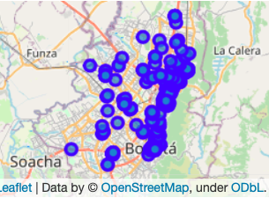
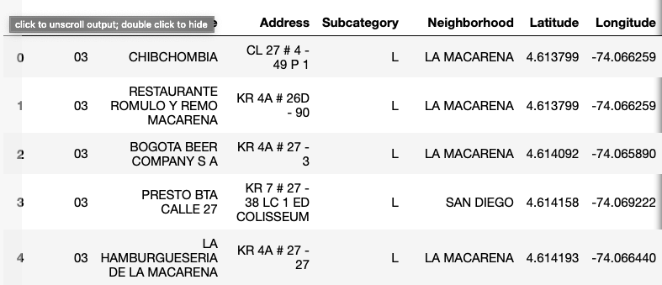
Restaurants/Bar Geolocation
High concentration of registred restaurants in the west of Bogota, un the Chapinero and Usqaquen Borough

Slide 4
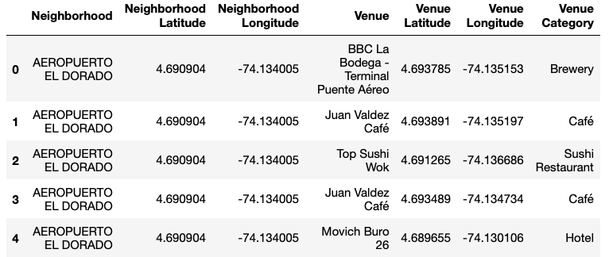
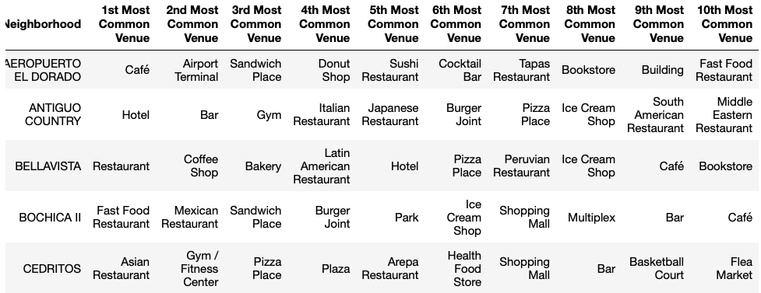
FOURSQUARE Data Acquisition and processing
Initial
Processed

Slide 5
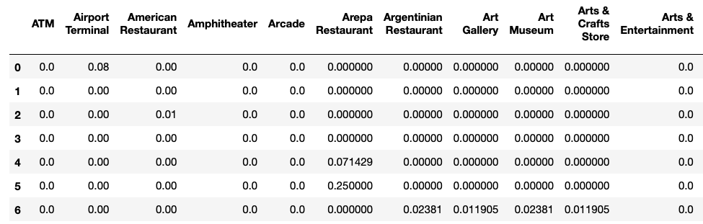
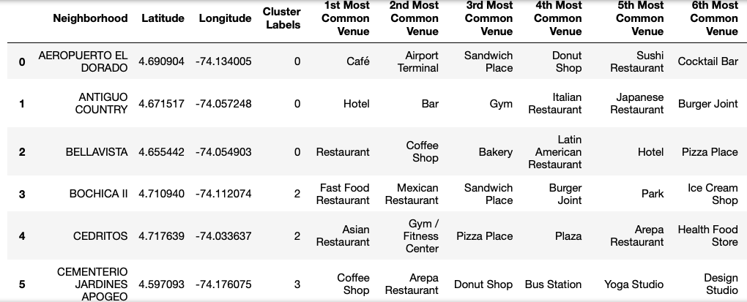
Kmeans Clustering
Kmeans Input
Kmeans Clusters by Venues Category in each neighborhood

Slide 6
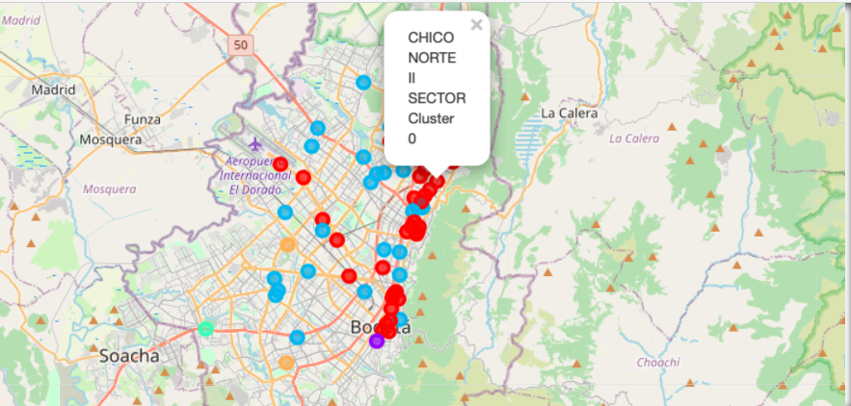
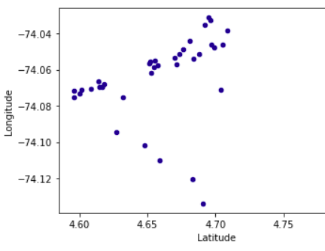
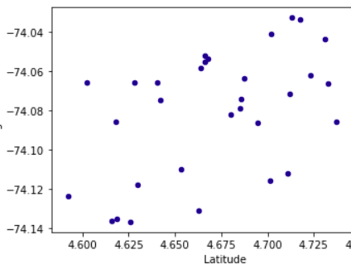
Clusters Geolocation
Cluster = 0
Cluster = 2

Slide 7
Results
The analysis shows that although there is a great number of restaurants in Bogotá, there are pockets of low restaurant density on the east and north. Highest concentration of restaurants was detected on west and downtwon , so we focused our attention to areasto north-west, west and south west, corresponding to boroughs Chapinero, Usaquen and Santa Fe. Another borough was identified as potentially interesting (Salitre), but our attention was focused on Chapinero and Usaquen which offer a combination of popularity among tourists, closeness to city center, strong socio-economic dynamics.

Slide 8
Conclusion
After the Clustering was applied, the cluster number 1 and 4, showed a high density of restaurants of different categories, however as can be seen in the map and the scatter plot, it can be seen that the neighborhoods of cluster 1 are geographically closer, which would allow positioning the supply store that would have a greater potential market, reason why it is necessary to look for a location in one of these neighborhoods.

